Slide 1
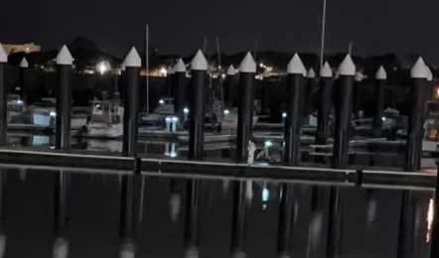
This is a crop of a time lapse (it’s a movie), right at the failure moment. This is running at 60x, so this video covers just under 4 minutes of real time.
Watch the white (I think it’s a mini bollard or electric) and what looks like a cart / chair on the dock in the center of the video
It looks like the dock moves downward!

Slide 2
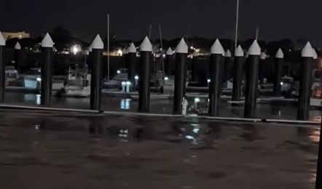
Surge front is just about to hit the dock
Time: 0
Bollard / electric and cart
Dock
Surge
Frame 43

Slide 3
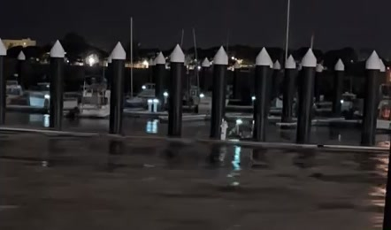
Surge hitting and starting to over-run the dock, which is not rising quickly enough
Time: +2 seconds
Frame 44

Slide 4
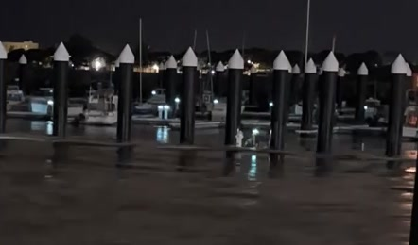
Dock has ~0.5’ of water overtopping.
Dock begins to uniformly sink
Time: +6 seconds
Frame 46

Slide 5
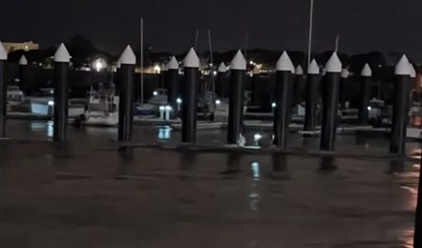
Dock continues to sink. No obvious kinking of dock, as the bollard and the cart are sinking together
Time: +16 seconds
Frame 51

Slide 6
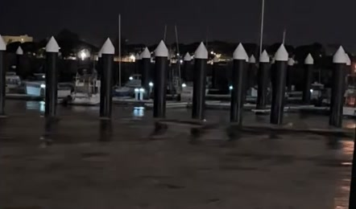
Dock continues to sink. Now only the very top of the bollard is out of the water
Time: +26 seconds
Frame 56

Slide 7
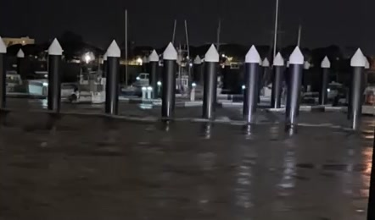
Bollard has been fully submerged now for 1.5 minutes
Time: +118 seconds
Frame 102

Slide 8
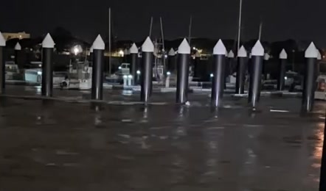
Bollard and parts of the floating dock are starting to pop back out of the water now, as currents slacken
Time: +122 seconds
Bollard
Dock
Frame 104

Slide 9
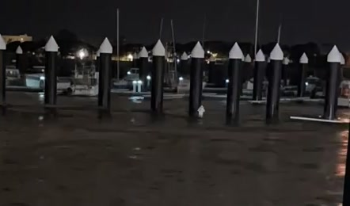
With the docks emerging, we see they have disconnected from each other and are kinked.
Time: +128 seconds
Frame 107

Slide 10
What we are seeing is classic fluid dynamics, driven by probably two but maybe one effect(s):
Effect 1) These docks have a large vertical width, forcing (accelerating) the tsunami currents underneath the docks. This increase in speed leads to a decrease in pressure, or effectively a force pulling the dock downwards. This “negative lift” works against the buoyant force, and when greater will pull the dock underwater. Effect 2) As the dock was unable to match the rise of the water (not sure if this is a friction effect on the pile-to-guide or a negative lift effect due to low pressure on the dock bottom or both), water overtops the deck, leading to an additional downward vertical weight force. Not clear to me if this effect is needed, or if this failure occurs just with 1), once the currents are strong enough.
So, this is a current-driven “sink” failure, and may in fact be common – we have just never seen it before. Because these docks and pile guides have so much load bearing capacity, they mostly survived being submerged. A normal dock would have failed immediately.
Cheaply solved by adding empty closed tanks / containers bolted to the docks. Better solved by engineering the shape of the dock to reduce the negative lift.

